Slide 1
Virtual Memory, Address-Translation and Paging
INF-2201 Operating Systems Fundamentals – Spring 2017
Lars Ailo Bongo, larsab@cs.uit.no
Based on presentations created by
Bård Fjukstad, Daniel Stødle
And Kai Li and Andy Bavier, Princeton
(http://www.cs.princeton.edu/courses/cos318/)
Tanenbaum & Bo,Modern Operating Systems:4th ed.

Slide 2
Summary – Part 1
Virtual Memory
Virtualization makes software development easier and enables memory resource utilization better
Separate address spaces provide protection and isolate faults
Address translation
Base and bound: very simple but limited
Segmentation: useful but complex
Paging
TLB: fast translation for paging
VM needs to take care of TLB consistency issues

Slide 3
Virtual-to-physical address translation using the page table (64-bits).
From: http://www.pearsonhighered.com/samplechapter/0130610143.pdf

Slide 4
Overview
Part 1: Virtual Memory and Address Translation
Part 2
Paging mechanism
Page replacement algorithms
Part 3: Design Issues

Slide 5
Virtual Memory Paging
Simple world
Load entire process into memory. Run it. Exit.
Problems
Slow (especially with big processes)
Wasteful of space (doesn’t use all of its memory all the time)
Solution
Demand paging: only bring in pages actually used
Paging: only keep frequently used pages in memory
Mechanism:
Virtual memory maps some to physical pages, some to disk

Slide 6
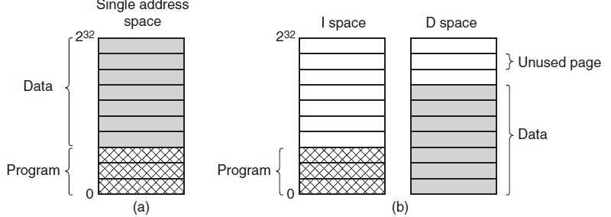
Separate Instruction and Data Spaces
Figure 3-24. (a) One address space. (b) Separate I and D spaces.
Tanenbaum & Bo,Modern Operating Systems:4th ed., (c) 2013 Prentice-Hall, Inc. All rights reserved.

Slide 7
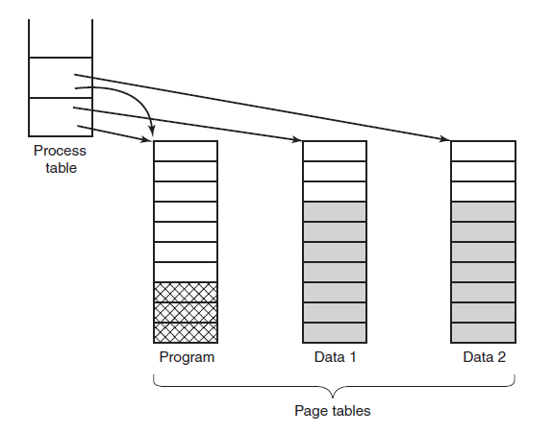
Shared Pages
Figure 3-25. Two processes sharing the same program sharing its page table.
Tanenbaum & Bo,Modern Operating Systems:4th ed., (c) 2013 Prentice-Hall, Inc. All rights reserved.

Slide 8
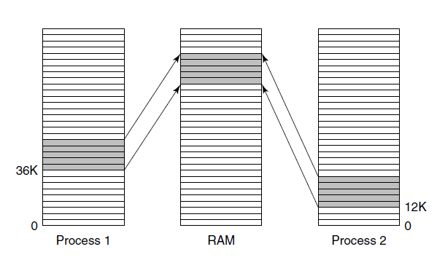
Shared Libraries
Figure 3-26. A shared library being used by two processes.
Tanenbaum & Bo,Modern Operating Systems:4th ed., (c) 2013 Prentice-Hall, Inc. All rights reserved.

Slide 9
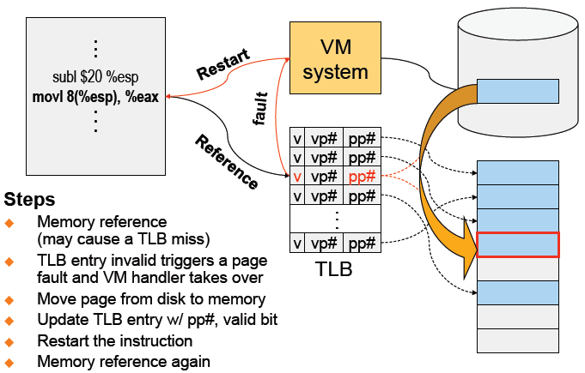
VM Paging Steps

Slide 10
Virtual Memory Issues
How to switch a process after a fault?
Need to save state and resume
Is it the same as an interrupt?
What to page in?
Just the faulting page or more?
Want to know the future…
What to replace?
Cache always too small, which page to replace?
Want to know the future...

Slide 11
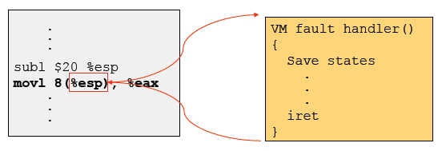
How Does Page Fault Work?
User program should not be aware of the page fault
Fault may have happened in the middle of the instruction!
Can we skip the faulting instruction?
Is a faulting instruction always restartable?

Slide 12
What to Page In?
Page in the faulting page
Simplest, but each “page in” has substantial overhead
Page in more pages each time
May reduce page faults if the additional pages are used
Waste space and time if they are not used
Real systems do some kind of prefetching
Applications control what to page in
Some systems support for user-controlled prefetching
But, many applications do not always know

Slide 13
VM Page Replacement
Things are not always available when you want them
It is possible that no unused page frame is available
VM needs to do page replacement
On a page fault
If there is an unused frame, get it
If no unused page frame available,
Find a used page frame
If it has been modified, write it to disk
Invalidate its current PTE and TLB entry
Load the new page from disk
Update the faulting PTE and remove its TLB entry
Restart the faulting instruction
General data structures
A list of unused page frames
A table to map page frames to PID and virtual pages, why?
Page replacement

Slide 14
Which “Used” Page Frame To Replace?
Random
Optimal or MIN algorithm
NRU (Not Recently Used)
FIFO (First-In-First-Out)
FIFO with second chance
Clock
LRU (Least Recently Used)
NFU (Not Frequently Used)
Aging (approximate LRU)
Working Set
WSClock

Slide 15

Optimal or MIN
Algorithm:
Replace the page that won’t be used for the longest time (Know all references in the future)
Example
Reference string:
4 page frames, 5 virtual pages
6 faults
Pros
Optimal solution and can be used as an off-line analysis method
Cons
No on-line implementation
Notes:
RED: page accessed and generate fault. Must be loaded.
BLACK: page accessed and is in memory.
Number represents which pages are accessed in which order.

Slide 16
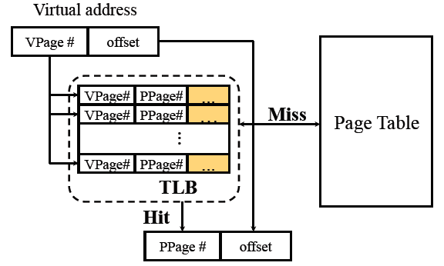
Revisit TLB and Page Table
Important bits for paging
Reference: Set when referencing a location in the page
Modify: Set when writing to a location in the page

Slide 17

Not Recently Used (NRU)
Algorithm
Randomly pick a page from the following (in this order)
Not referenced and not modified
Not referenced and modified
Referenced and not modified
Referenced and modified
Clear reference bits
Example
4 page frames
Reference string
8 page faults
Pros
Implementable
Cons
Require scanning through reference bits and modified bits

Slide 18


First-In-First-Out (FIFO)
Algorithm
Throw out the oldest page
Example
4 page frames
Reference string
10 page faults
Pros
Low-overhead implementation
Cons
May replace the heavily used pages

Slide 19


More Frames → Fewer Page Faults?
Consider the following with 4 page frames
Algorithm: FIFO replacement
Reference string:
10 page faults
Same string with 3 page frames
Algorithm: FIFO replacement
Reference string:
9 page faults!
This is so called “Belady’s anomaly” (Belady, Nelson, Shedler 1969)

Slide 20


FIFO with 2nd Chance
Algorithm
Check the reference-bit of the oldest page
If it is 0, then replace it
If it is 1, clear the referent-bit, put it to the end of the list, and continue searching
Example
4 page frames
Reference string:
8 page faults
Pros
Simple to implement
Cons
The worst case may take a long time

Slide 21
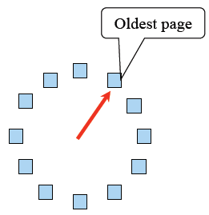
Clock
FIFO clock algorithm
Hand points to the oldest page
On a page fault, follow the hand to inspect pages
Second chance
If the reference bit is 1, set it to 0 and advance the hand
If the reference bit is 0, use it for replacement
Compare with the FIFO with 2nd chance
What’s the difference?
What if memory is very large
Take a long time to go around?

Slide 22


Least Recently Used (LRU)
Algorithm
Replace page that hasn’t been used for the longest time
Order the pages by time of reference
Timestamp for each referenced page
Example
4 page frames
Reference string:
8 page faults
Pros
Good to approximate MIN
Cons
Difficult to implement

Slide 23
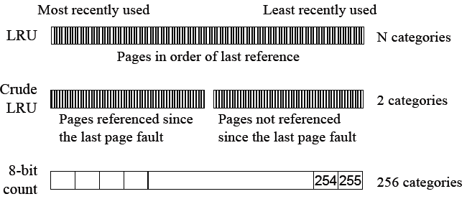
Approximation of LRU
Use CPU ticks
For each memory reference, store the ticks in its PTE
Find the page with minimal ticks value to replace
Use a smaller counter

Slide 24
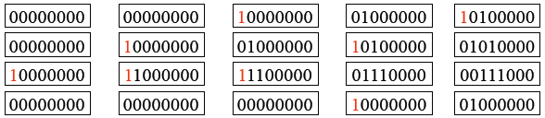

Aging: Not Frequently Used (NFU)
Algorithm
Shift reference bits into counters
Pick the page with the smallest counter to replace
Old example
4 page frames
Reference string:
8 page faults
Main difference between NFU and LRU?
NFU has a short history (counter length)
How many bits are enough?
In practice 8 bits are quite good

Slide 25
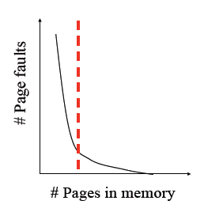
Program Behavior (Denning 1968)
80/20 rule
> 80% memory references are within <20% of memory space
> 80% memory references are made by < 20% of code
Spatial locality
Neighbors are likely to be accessed
Temporal locality
The same page is likely to be accessed again in the near future

Slide 26
Working Set
Main idea (Denning 1968, 1970)
Define a working set as the set of pages in the most recent K page references
Keep the working set in memory will reduce page faults significantly
Approximate working set
The set of pages of a process used in the last T seconds
An algorithm
On a page fault, scan through all pages of the process
If the reference bit is 1, record the current time for the page
If the reference bit is 0, check the “time of last use,”
If the page has not been used within T, replace the page
Otherwise, go to the next
Add the faulting page to the working set

Slide 27
WSClock
Follow the clock hand
If the reference bit is 1
Set reference bit to 0
Set the current time for the page
Advance the clock hand
If the reference bit is 0, check “time of last use”
If the page has been used within δ, go to the next
If the page has not been used within δ and modify bit is 1
Schedule the page for page out and go to the next
If the page has not been used within δ and modify bit is 0
Replace this page

Slide 28
Replacement Algorithms
The algorithms
Random
Optimal or MIN algorithm
NRU (Not Recently Used)
FIFO (First-In-First-Out)
FIFO with second chance
Clock
LRU (Least Recently Used)
NFU (Not Frequently Used)
Aging (approximate LRU)
Working Set
WSClock
Which are your top two?

Slide 29
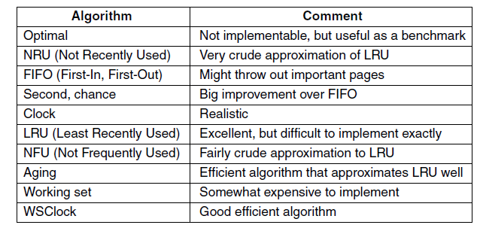
Summary of Page Replacement Algorithms
Figure 3-21. Page replacement algorithms discussed in the text.
Tanenbaum & Bo,Modern Operating Systems:4th ed., (c) 2013 Prentice-Hall, Inc. All rights reserved.

Slide 30
Summary – Part 2
VM paging
Page fault handler
What to page in
What to page out
LRU is good but difficult to implement
Clock (FIFO with 2nd hand) is considered a good practical solution
Working set concept is important
Notes:
Tilsvarende problemer også innenfor web proxies, web caches etc.

Slide 31
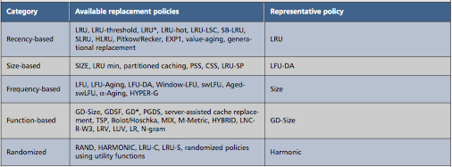
Similarities with caching
Web Cache Replacement Policies: A Pragmatic Approach
Kin-Yeung Wong, Macao Polytechnic Institute
IEEE Network • January/February 2006
Notes:
More and complex algorithms

Slide 32
Overview
Part 1: Virtual Memory and Address Translation
Part 2: Paging and replacement
Part 3: Design Issues
Thrashing and working set
Backing store
Simulate certain PTE bits
Pin/lock pages
Zero pages
Shared pages
Copy-on-write
Distributed shared memory
Virtual memory in Unix and Linux
Virtual memory in Windows 2000/ XP

Slide 33
Virtual Memory Design Implications
Revisit Design goals
Protection
Isolate faults among processes
Virtualization
Use disk to extend physical memory
Make virtualized memory user friendly (from 0 to high address)
Implications
TLB overhead and TLB entry management
Paging between DRAM and disk
VM access time
Access time = h × memory access time + ( 1 - h ) × disk access time
E.g. Suppose memory access time = 100ns, disk access time = 10ms
If h = 90%, VM access time is 1ms!

Slide 34
Thrashing
Thrashing
Paging in and paging out all the time, I/O devices fully utilized
Processes block, waiting for pages to be fetched from disk
Reasons
Processes require more physical memory than it has
Does not reuse memory well
Reuses memory, but it does not fit
Too many processes, even though they individually fit
Solution: working set (previous part)
Pages referenced by a process in the last T seconds
Two design questions
Which working set should be in memory?
How to allocate pages?

Slide 35
Working Set: Fit in Memory
Maintain two groups
Active: working set loaded
Inactive: working set intentionally not loaded
Two schedulers
A short-term scheduler schedules processes
A long-term scheduler decides which one active and which one inactive, such that active working sets fits in memory (swapper)
A key design point
How to decide which processes should be inactive
Typical method is to use a threshold on waiting time

Slide 36
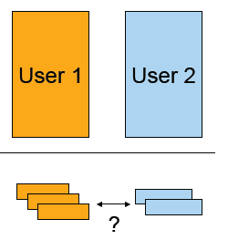
Working Set: Global vs. Local Page Allocation
The simplest is global allocation only
Pros: Pool sizes are adaptable
Cons: Too adaptable, little isolation (example?)
A balanced allocation strategy
Each process has its own pool of pages
Paging allocates from its own pool and replaces from its own working set
Use a “slow” mechanism to change the allocations to each pool while providing isolation
Design questions:
What is “slow?”
How big is each pool?
When to migrate?

Slide 37
Backing Store
Swap space
When process is created, allocate a swap space for it
Need to load or copy executables to the swap space
Need to consider process space growth
Page creation
Allocate a disk address?
What if the page never swaps out?
What if the page never gets modified?
Swap out
Use the same disk address?
Allocate a new disk address?
Swap out one or multiple pages?
Text (code) pages
They are read only in most cases. Treat them differently?

Slide 38
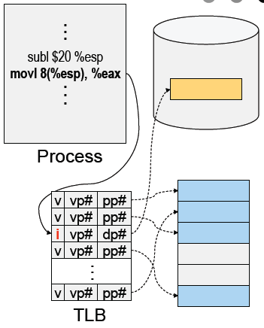
Revisit Address Translation
Map to page frame and disk
If valid bit = 1, map to pp# physical page number
If valid bit = 0, map to dp# disk page number
Page out
Invalidate page table entry and TLB entry
Copy page to disk
Set disk page number in PTE
Page in
Find an empty page frame (may trigger replacement)
Copy page from disk
Set page number in PTE and TLB entry and make them valid

Slide 39
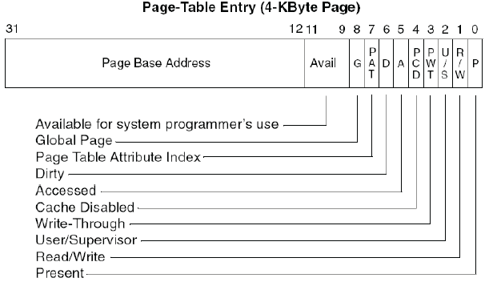
Example: x86 Paging Options
Flags
PG flag (Bit 31 of CR0): enable page translation
PSE flag (Bit 4 of CR4): 0 for 4KB page size and 1 for large page size
PAE flag (Bit 5 of CR4): 0 for 2MB pages when PSE = 1 and 1 for 4MB pages when PSE = 1 extending physical address space to 36 bit
2MB and 4MB pages are mapped directly from directory entries
4KB and 4MB pages can be mixed
Notes:
PAE: Physical address Extension, for accessing more than 4GB memory on 32 bit architecture
(Windows 8 still has limit to 4 GB in 32 bit version)
PSE: A feature of x86 processors that extends the physical memory addressing capabilities from
32 bits to 36 bits, allowing addressing to up to 64 GB of memory
PG: Enables page translation.
Remark: MIX OF 4KB and 4MB IS OK!!!

Slide 40
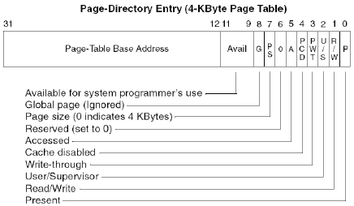
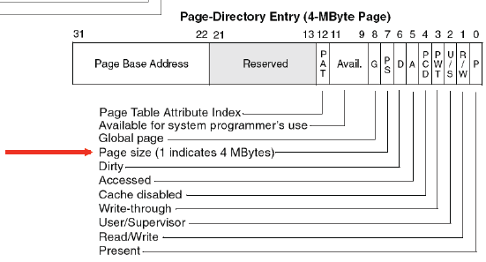
Example: x86 Directory Entry

Slide 41
PAE
4 KB pages
4 MB pages
http://en.wikipedia.org/wiki/Physical_Address_Extension

Slide 42
Simulating PTE Bits
Simulating modify bit using read/write bit
Set pages read-only if they are read-write
Use a reserved bit to remember if the page is really read-only
On a write fault
If it is not really read-only, then record a modify in the data structure and change it to read-write
Restart the instruction
Simulating access (reference) bit using valid bit
Invalidate all valid bits (even they are valid)
Use a reserved bit to remember if a page is really valid
On a page fault
If it is a valid reference, set the valid bit and place the page in the LRU list
If it is a invalid reference, do the page replacement
Restart the faulting instruction
Notes:
Bemerk: Linux på ARM har ikke reference bits.
The lack of hardware functionality is made up for by providing two page tables – the processor-native page tables, with neither referenced bits nor dirty bits, and software-maintained page tables with the required bits present. The emulated bits in the software-maintained table are set by page faults. In order to get the page faults, clearing emulated bits in the second table revokes some of the access rights to the corresponding page, which is implemented by altering the native table.

Slide 43
Pin (or Lock) Page Frames
When do you need it?
When DMA is in progress, you don’t want to page the pages out to avoid CPU from overwriting the pages
How to design the mechanism?
A data structure to remember all pinned pages
Paging algorithm checks the data structure to decide on page replacement
Special calls to pin and unpin certain pages
How would you implement the pin/unpin calls?
If the entire kernel is in physical memory, do we still need these calls?

Slide 44
Zero Pages
Zeroing pages
Initialize pages with 0’s
Heap and static data are initialized
How to implement?
On the first page fault on a data page or stack page, zero it
Have a special thread zeroing pages
Can you get away without zeroing pages?

Slide 45
Shared Pages
Two processes sharing two segments,
TEXT, that will never be written to.
From: http://www.pearsonhighered.com/samplechapter/0130610143.pdf
Notes:
Processes may also want to share pages explicitly. «mmap()» does this.

Slide 46
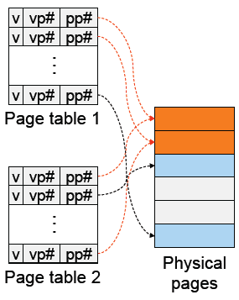
Shared Pages
PTEs from two processes share the same physical pages
What use cases?
APIs
Shared memory calls
Implementation issues
Destroy a process with share pages
Page in, page out shared pages
Pin and unpin shared pages
Derive the working set for a process with shared pages

Slide 47
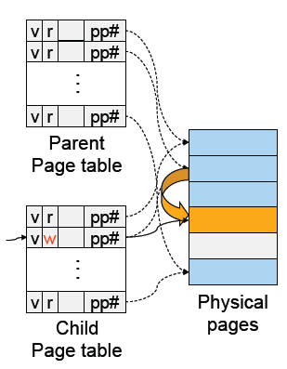

Copy-On-Write
A technique to avoid prepare all pages to run a large process
Method
Child’s address space uses the same mapping as parent’s
Make all pages read-only
Make child process ready
On a read, nothing happens
On a write, generates a fault
map to a new page frame
copy the page over
restart the instruction
Issues
How to destroy an address space?
How to page in and page out?
How to pin and unpin?

Slide 48
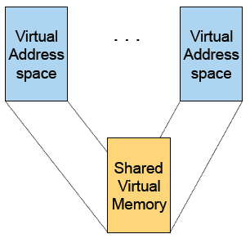
Distributed Shared Memory
Run shared memory program on a cluster of computers
Method
Multiple address space mapped to “shared virtual memory”
Page access bits are set according to coherence rules
Exclusive writer
N readers
A read fault will invalidate the writer, make read only and copy the page
A write fault will invalidate another writer or all readers and copy page
Issues
Thrashing
Copy page overhead

Slide 49
Separation of Policy and Mechanism
Memory management system is divided into three parts
A low-level MMU handler.
A page fault handler that is part of the kernel.
An external pager running in user space.
INF-2201-2015, B. Fjukstad

Slide 50
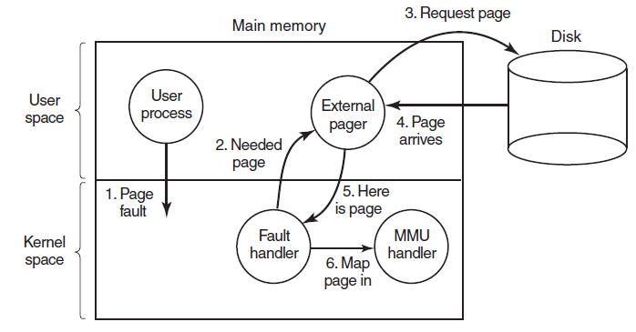
Separation of Policy and Mechanism
Figure 3-29. Page fault handling with an external pager.
INF-2201-2015, B. Fjukstad

Slide 51
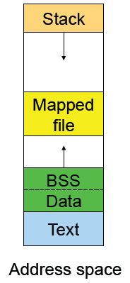
Address Space in Unix
Stack
Data
Un-initialized: BSS (Block Started by Symbol)
Initialized
brk(addr) to grow or shrink
Text: read-only
Mapped files
Map a file in memory
mmap(addr, len, prot, flags, fd, offset)
unmap(addr, len)

Slide 52
Virtual Memory in BSD4
Physical memory partition
Core map (pinned): everything about page frames
Kernel (pinned): the rest of the kernel memory
Frames: for user processes
Page replacement
Run page daemon until there is enough free pages
Early BSD used the basic Clock (FIFO with 2nd chance)
Later BSD used Two-handed Clock algorithm
Swapper runs if page daemon can’t get enough free pages
Looks for processes idling for 20 seconds or more
4 largest processes
Check when a process should be swapped in

Slide 53
Virtual Memory in Linux (32-bit)
Linux address space for 32-bit machines
3GB user space
1GB kernel (invisible at user level)
Backing store
Text segment uses executable binary file as backing storage
Other segments get backing storage on demand
Copy-on-write for forking off processes
Multi-level paging
Directory, middle (nil for Pentium), page, offset
Kernel is pinned
Buddy algorithm with carving slabs for page frame allocation
Replacement
Keep certain number of pages free
Clock algorithm on paging cache and file buffer cache
Clock algorithm on unused shared pages
Modified Clock on memory of user processes (most physical pages first)

Slide 54
Virtual Memory in Linux (64 bits)
Page Global Directory, pgd,
Page Middle Directories, pmd
From: http://www.pearsonhighered.com/samplechapter/0130610143.pdf
Notes:
pgd( Page Global Directory), pmd(Page Middle Directories), PTE(Page Table Entries).
The primary benefit of implementing a page table with a multiway tree instead of a linear array is that the former takes up space that is proportional only to the virtual address space actually in use, instead of being proportional to the maximum size of the virtual address space.
Another benefit of multiway trees is that each node (directory) in the tree has a fixed- size (usually a page).

Slide 55
Virtual-to-physical address translation using the page table.
From: http://www.pearsonhighered.com/samplechapter/0130610143.pdf

Slide 56
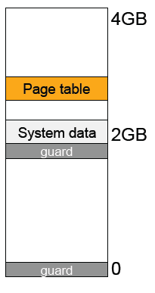
Address Space in Windows 2K/XP
Win2k user address space
Upper 2GB for kernel (shared)
Lower 2GB – 256MB are for user code and data (Advanced server uses 3GB instead)
The 256MB contains for system data (counters and stats) for user to read
64KB guard at both ends
Virtual pages
Page size
4KB for x86
8 or 16KB for IA64
States
Free: not in use and cause a fault
Committed: mapped and in use
Reserved: not mapped but allocated

Slide 57
Backing Store in Windows 2K/XP
Backing store allocation
Win2k delays backing store page assignments until paging out
There are up to 16 paging files, each with an initial and max sizes
Memory mapped files
Delayed write back
Multiple processes can share mapped files w/ different accesses
Implement copy-on-write

Slide 58
Paging in Windows 2K/XP
Each process has a working set with
Min size with initial value of 20-50 pages
Max size with initial value of 45-345 pages
On a page fault
If working set < min, add a page to the working set
If working set > max, replace a page from the working set
If a process has a lot of paging activities, increase its max
Working set manager maintains a large number of free pages
In the order of process size and idle time
If working set < min, do nothing
Otherwise, page out the pages with highest “non-reference” counters in a working set for uniprocessors
Page out the oldest pages in a working set for multiprocessors
The last 512 pages are never taken for paging

Slide 59
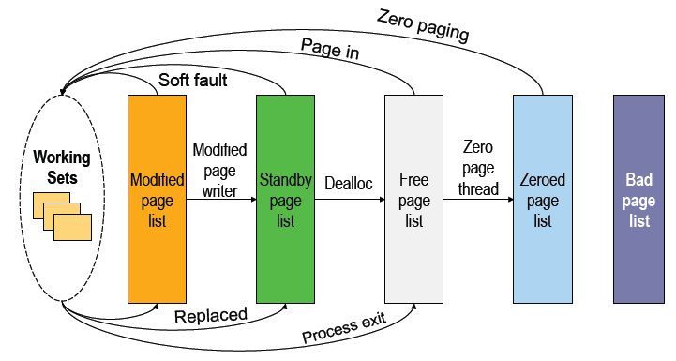
More Paging in Windows 2K/XP

Slide 60
Summary – Part 3
Must consider many issues
Global and local replacement strategies
Management of backing store
Primitive operations
Pin/lock pages
Zero pages
Shared pages
Copy-on-write
Shared virtual memory can be implemented using access bits
Real system designs are complex

Slide 61
Learn More
Virtual Memory on 64-bit architectures
How do they implement paging?
Multi-level page table or inverted page table?
How is the TLB implemented?
Hardware or software?
Size?
How big is the address space provided to processes?
2⁶⁴?
How is the address space used?
Are there problems we avoid compared to 32-bit architectures?
Are there new problems?
Notes:
Largest known physical memory chip 2^48 bits ( Several TB ) until now.

